Slide 1
Exploring the power and limitation of bootstrap technique in statistics
Semester project presentation
Project supervisor: Prof.KANAGAWA Motonobu
Student’s Name: Nandhini MAGUDESWARAN

Slide 2
Bootstrap Techniques
Recent technique to make certain kind of statistical inference.
-To analyze,summarize and how accurate the collected data.
The Main goal is to implement computer based of statistical concepts.
For example: The mouse data for prolong survival treatment.

Slide 3
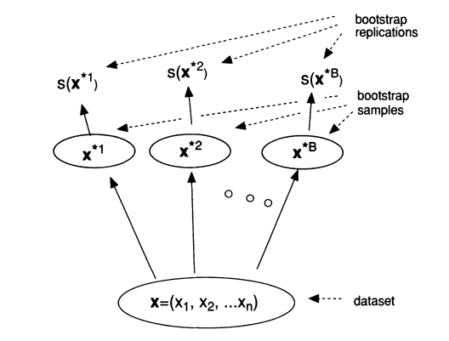
Bootstrap Techniques
Bootstrapping is a method for estimating the sampling distribution of an estimator by resampling with replacement from the original sample.
The Results generated from the bootstrap samples can
be treated with the actual sampling of original data.

Slide 4
Bias Estimation
Bootstrap easily adapts for estimating bias.
It shows :
Model accuracy.
Correcting errors.
Transparency
Quality assessment

Slide 5
Bias Estimation
The simple and resampling across an increasing number of bootstrap samples
SIMPLE BIAS ESTIMATE - the bias is calculated by comparing the average of the estimated values to the true population parameter.
RESAMPLING METHOD introduces resampling vector is adjusted to bias estimate the of the resampled estimate with the original estimate.

Slide 6
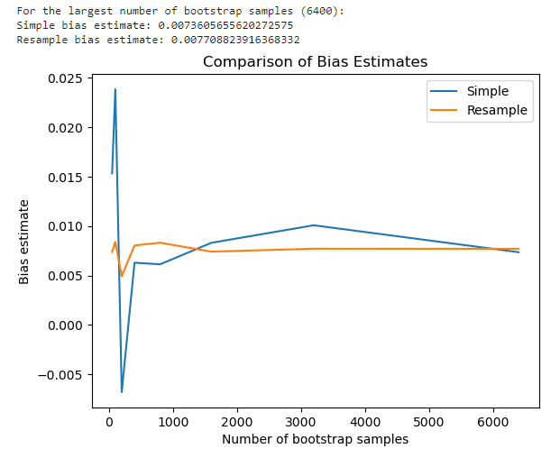
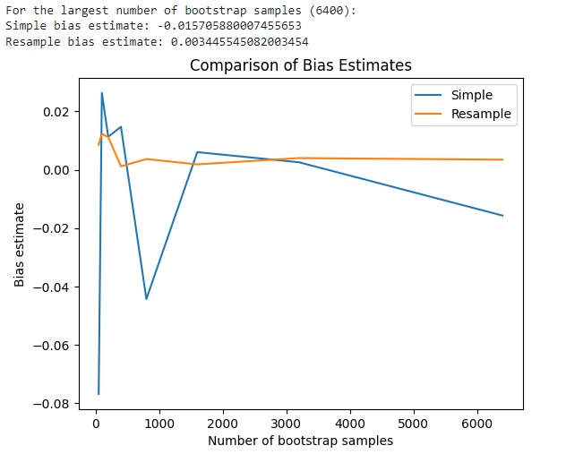
Bias Estimation

Slide 7
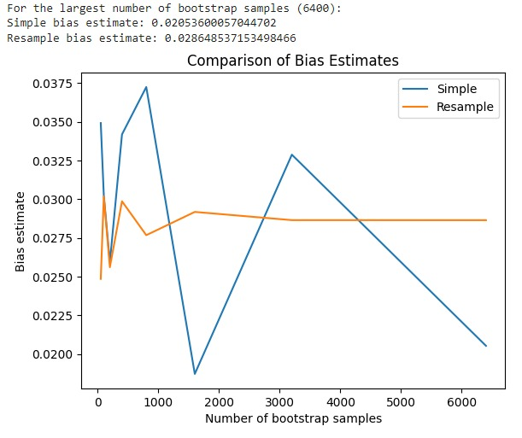
Bias Estimation

Slide 8
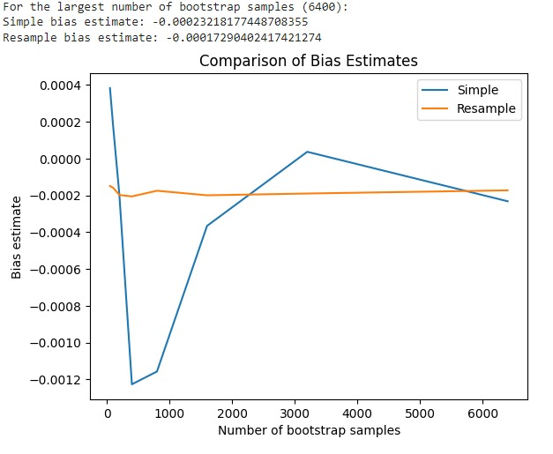
Bias Estimation

Slide 9
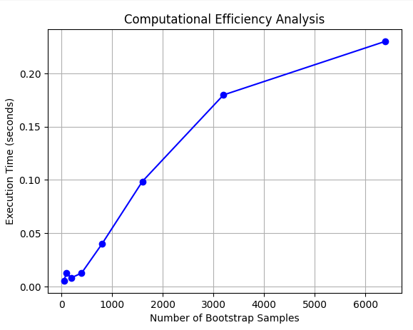
Computational Analysis

Slide 10
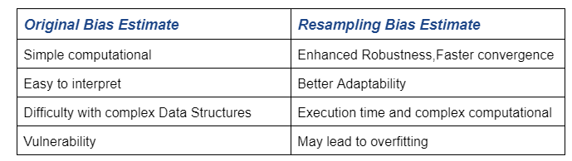
Comparison between original and resample approach.

Slide 11
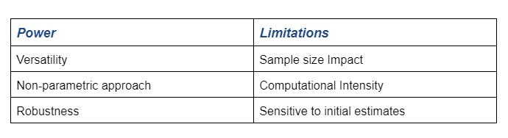
Power and limitations in Bootstrap

Slide 12
Discussion
Algorithmic optimization.
Integration with machine learning models.
Based on the goal and characteristics the bias estimation between these approaches can be used.

